Slide 1
Planning Accessible and Inclusive Events
Notes:
World Interaction Design Day - Inclusive and Accessible Design Presentation Series

Slide 2
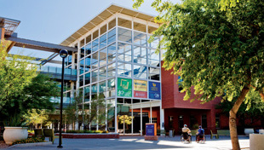
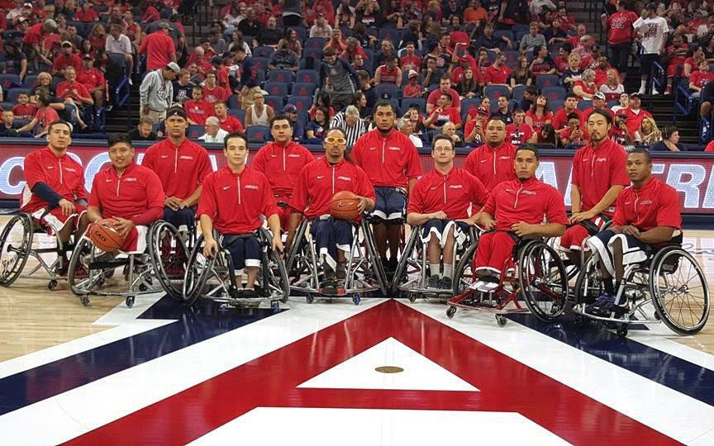
Disability Resource Center
Services
Students
Staff
Guests
Areas of Access & Accommodations: Classroom, Workplace, Campus, IT/Digital, Community
Largest collegiate adaptive athletics program in US
Notes:
Services
Students:
Testing accommodations, in-class captioning/interpreting, alternate formatting
Staff:
Workplace accommodations
Guests:
Sign language interpreting, alternative print formats, captioning, assistive technology
Largest collegiate adaptive athletics program in US
5 adaptive sports teams
Scholarships, adaptive gym/fitness center, wheelchair repair shop

Slide 3
Philosophy
Goal: Ensure that disabled students, employees and visitors, have a similar, if not identical, experience to that of their non-disabled counterparts.
Universal Design
Access vs. Inclusion
Notes:
Work proactively to impact the systemic design of our campus environments to be universally designed, reducing or eliminating the need for any individual accommodations or modifications.

Slide 4
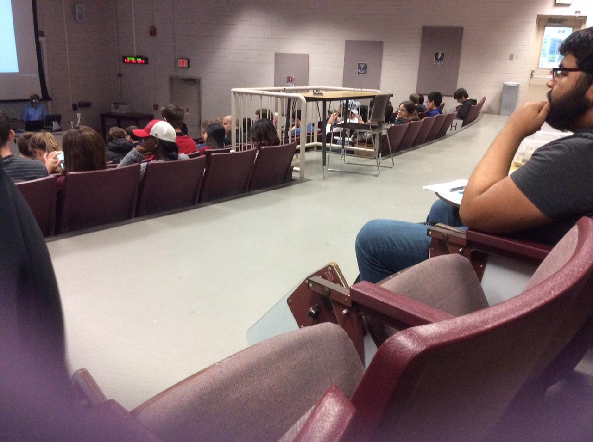
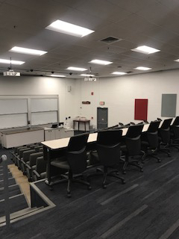
Accessible vs. Inclusive
Before
After
Notes:
PAS 201

Slide 5
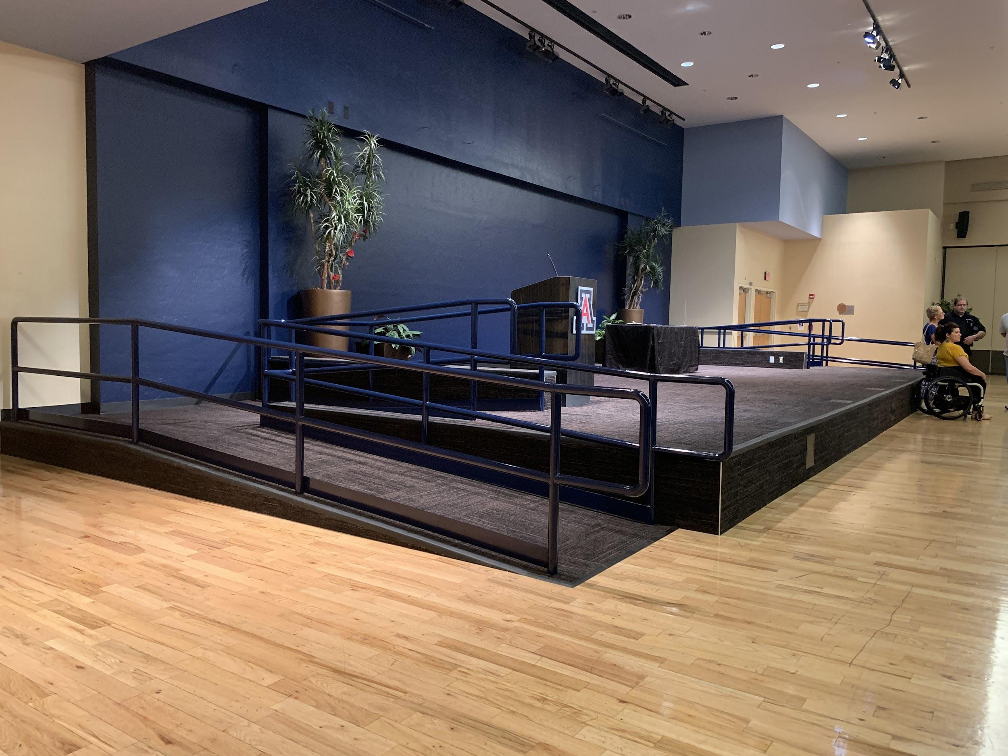
SU Ballroom Stage

Slide 6
Event Planning

Slide 7
Picking a Venue
Layout significantly impacts your event (seating location)
Types of room (Tiered vs. flat spaces)
Furniture (Movable or. fixed)
Event structure (i.e., presentation or. activity)
Visiting a venue
Notes:
One of the most important steps in the planning process is the selection of an appropriate venue.

Slide 8
Classroom Accessibility Information

Slide 9
Event Layout
Parking and routes to the event space
Universal entrances, registration/check-in, etc.
Routes through the event
Restrooms, food/drink, stage, etc.
Visit the venue when scheduling and just prior to the event

Slide 10
Marketing your Event
Websites, Flyers, Emails
Basics:
Label images with alternative text
Avoid using a full page image without any text
Use self describing text for any links – avoid “click here”
Ensure good color contrast
Include information about your event’s access features
Notes:
You want everyone to come to your event, right? You need to make sure that everyone can get your message about your event!
Full page image without text is inaccessible for a variety of reasons … To ensure better access for all types of users and how they will interact with your message - maybe its someone opening your flyer emailed on their cell phone, they might not want to use phone space to open up the image of the flyer but if there’s not text in the email they won’t know what it is - if they have bad cell phone service - the mobile device may be unable to open the attachment. For any recipients of the message that use assistive technology to view emails - the technology will not have any text to read and indicate what the flyer is about.
Instead of saying - To register for this event “Click here” - use : “Register for event here” as the link itself

Slide 11
Accessibility Statement
This statement should be included on all marketing materials, online or printed:
“With questions about access or to request any disability-related accommodations that will facilitate your full participation on this [insert text: workshop, training, seminar] such as ASL interpreting, CART captioning, captioned videos, Braille, wheelchair access, or electronic text, etc., please contact {Event Planner's name and contact information including an email or phone number}.”
Notes:
Event planners can modify to fit event (accommodations)

Slide 12
Language
Do
Accessible
Disability Related Accommodations
Wheelchair User
Don’t
Handicap
Special Needs/ Accommodations
Wheelchair Bound

Slide 13
Signage

Slide 14
After your Event

Slide 15
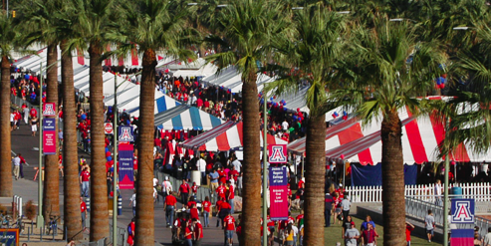
Event Follow-Up
Include question about access on evaluations or assessments
When posting recordings ensure captions are provided or can be requested
Reflect on disability-related accommodations

Slide 16
Resources
IT Accessibility: itaccessibility.arizona.edu
Accessible Presentation Techniques
Color Contrast Checker
Website Accessibility
PDF and Office product accessibility tools
DRC Website:
drc.arizona.edu
Event Planning Guide
Classroom Accessibility Information (CTS Website)
Captioning/Interpreting Request Form
Notes:
DRC is your resource!

Slide 17
Please contact DRC early and often with any questions about planning!
Eric Bell
Physical Access Consultant
(520) 621-4955
ericbell@arizona.edu
eventaccess@arizona.edu

Slide 18
Thank you! Questions?

Slide 22
Event Access

Slide 23
Presentation - Video?
Do not rely on Auto-Captions!
Know the difference:
No captions
“English (auto-generated) vs. English
Notes:
Youtube popular – click on the button to turn on captions and pay attention to the upper left-hand corner of the screen when button is pressed. If it says “auto-generated” they are auto captions

Slide 24
Presenters & Presentation
Does your presenter have any access concerns?
PowerPoint Presentation?
Use PowerPoint Slide templates / default layouts
Avoid using textboxes
Add alternate text for images, including SmartArt
Use good color contrast on slides
Provide presentation and handouts digitally
Notes:
Providing materials digitally ensures easier access in a variety of ways. For your presentation participants are able to follow along with your presentation and take notes, if they are unable to view it because they are far, they can view it on their own screen or maybe they’ve printed it out plus with assistive technology users they are able to follow along where you are in your presentation. Last, It also allows a more seamless access if you will have interpreters translating or CART captioners captioning every word you are saying. They are able to use the material to follow along with or properly spell and convey all of your material.

Slide 25
Presenting
Speak clearly.
Use simple language.
Give people time to process information.
Be visible.
Use a microphone.
Ensure that all relevant sound is audible through the sound system.
Cover all displayed text.
Describe pertinent parts of graphics, videos, and other visuals.
Describe other visual information.
Web Accessibility Initiative website
https://www.w3.org/WAI/teach-advocate/accessible-presentations/
Notes:
How to Make Your Presentations Accessible to All
Speak clearly.
And avoid speaking too fast, so participants and sign language interpreters can better understand you and keep up.
Use simple language.
Avoid or explain jargon, acronyms, and idioms. For example, expressions such as “raising the bar” can be interpreted literally by some people with cognitive disabilities and can be confusing.
Give people time to process information.
Pause between topics. When you ask if anyone has questions, some people with cognitive disabilities will need extra time to form their thoughts into words.
Be visible.
Be visible and in good light when you talk, so participants can see your face. This helps some people hear and understand better. Be careful not to face away from the audience to read projected material, particularly if you don’t have a microphone.
Use a microphone.
Some people might need the audio electronically, even in a small room. This includes people using ALDs/hearing loops and remote CART writers. Note that if you ask “Can everyone hear me OK?” some people might be uncomfortable saying that they cannot.
Ensure that all relevant sound is audible through the sound system.
For example, if the audience doesn’t have a microphone, repeat their questions and comments into your microphone before replying.
Cover all displayed text.
Say all of the information that is on each slide. (This does not mean that you have to read the slide exactly as it is. It just means that you cover the visual information in what you say.)
Describe pertinent parts of graphics, videos, and other visuals.
Describe them to the extent needed to understand the presentation. (You usually do not need to describe decorative images.)
Describe other visual information.
For example, a speaker asks people to raise their hands if they make their websites fully accessible. The speaker should then describe the visual response: “About half raised their hand”.

Slide 26
Stay Tuned!
Part Two: Creating Content for Everyone with Dawn Hunziker, Annissa Corsi, and Rebecca Blakiston, Wednesday, October 17, 3-4pm
Part Three: Designing Marketing for Everyone with Kenya Johnson and Shelly Black, Thursday, November 29, 3-4pm
Notes:
I barely scratched the surface on the creation of content and marketing – too much to cover!
Marketing involves the creation of a lot of content for your event.
Content accessibility could be a presentation on its’ own…. It is!

